Slide 1
xml

Slide 2
XML stands for eXtensible Markup Language
XML is a markup language much like HTML
XML was designed to store and transport data
XML was designed to be self-descriptive
XML is a W3C Recommendation

Slide 3
Example table
Title | Author
Everyday Italian | Giada De Laurentiis
Harry Potter | J K. Rowling
XQuery Kick Start | James McGovern
Learning XML | Erik T. Ray

Slide 4
<?xml version="1.0" encoding="UTF-8"?> <bookstore> <book category="cooking"> <title lang="en">Everyday Italian</title> <author>Giada De Laurentiis</author> <year>2005</year> <price>30.00</price> </book> <book category="children"> <title lang="en">Harry Potter</title> <author>J K. Rowling</author> <year>2005</year> <price>29.99</price> </book>

Slide 5
<book category="web"> <title lang="en">XQuery Kick Start</title> <author>James McGovern</author> <author>Per Bothner</author> <author>Kurt Cagle</author> <author>James Linn</author> <author>Vaidyanathan Nagarajan</author> <year>2003</year> <price>49.99</price> </book> <book category="web" cover="paperback"> <title lang="en">Learning XML</title> <author>Erik T. Ray</author> <year>2003</year> <price>39.95</price> </book>
</bookstore>

Slide 6
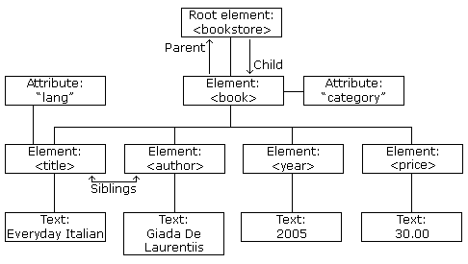
XML Tree Structure

Slide 7
XML Syntax Rules
The XML Prolog
XML Documents Must Have a Root Element
All XML Elements Must Have a Closing Tag
XML Tags are Case Sensitive
XML Elements Must be Properly Nested
XML Attribute Values Must Always be Quoted
Entity References
Comments in XML
White-space is Preserved in XML
Well Formed XML

Slide 8
1 <?xml version="1.0" encoding="UTF-8"?>
2 <root> <child> <subchild>.....</subchild> </child> </root>
<?xml version="1.0" encoding="UTF-8"?> <note> <to>Tove</to> <from>Jani</from> <heading>Reminder</heading> <body>Don't forget me this weekend!</body> </note>
3 <p>This is a paragraph.</p> <br />
4 <message>This is correct</message>
5 <b><i>This text is bold and italic</b></i>
5 <b><i>This text is bold and italic</i></b>
6 <note date="12/11/2007"> <to>Tove</to> <from>Jani</from> </note>

Slide 9
5 pre-defined entity references in XML:
7 <message>salary &lt; 1000</message>
&lt; | < | less than
&gt; | > | greater than
&amp; | & | ampersand
&apos; | ' | apostrophe
&quot; | " | quotation mark
Wrong <!-- This is an invalid -- comment -->
8 <!-- This is a comment -->

Slide 10
XML Naming Rules
Element names are case-sensitive
Element names must start with a letter or underscore
Element names cannot start with the letters xml (or XML, or Xml, etc)
Element names can contain letters, digits, hyphens, underscores, and periods
Element names cannot contain spaces

Slide 11
XML Namespaces
XML Namespaces provide a method to avoid element name conflicts.
Solving the Name Conflict Using a Prefix
XML Namespaces - The xmlns Attribute
When using prefixes in XML, a namespace for the prefix must be defined.
The namespace can be defined by an xmlns attribute in the start tag of an element.
The namespace declaration has the following syntax. xmlns:prefix="URI".

Slide 12
Uniform Resource Identifier (URI)
<root>
<h:table xmlns:h="http://www.w3.org/TR/html4/"> <h:tr> <h:td>Apples</h:td> <h:td>Bananas</h:td> </h:tr> </h:table> <f:table xmlns:f="https://www.w3schools.com/furniture"> <f:name>African Coffee Table</f:name> <f:width>80</f:width> <f:length>120</f:length> </f:table> </root>

Slide 13
XML DTD
An XML document with correct syntax is called "Well Formed".
An XML document validated against a DTD is both "Well Formed" and "Valid".
DTD stands for Document Type Definition.
A DTD defines the structure and the legal elements and attributes of an XML document.

Slide 14
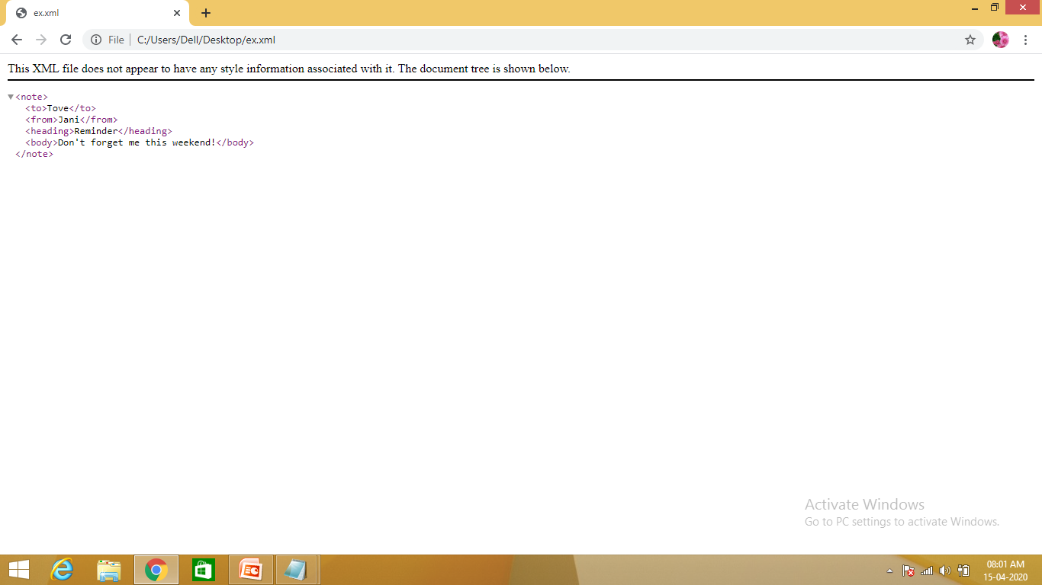
Valid XML Documents
<?xml version="1.0" encoding="UTF-8"?> <!DOCTYPE note SYSTEM "Note.dtd"> <note> <to>Tove</to> <from>Jani</from> <heading>Reminder</heading> <body>Don't forget me this weekend!</body> </note>

Slide 15
DTD
!DOCTYPE note - Defines that the root element of the document is note
!ELEMENT note - Defines that the note element must contain the elements: "to, from, heading, body"
!ELEMENT to - Defines the to element to be of type "#PCDATA"
!ELEMENT from - Defines the from element to be of type "#PCDATA"
!ELEMENT heading - Defines the heading element to be of type "#PCDATA"
!ELEMENT body - Defines the body element to be of type "#PCDATA"

Slide 16
Use a DTD
With a DTD, independent groups of people can agree to use a standard DTD for interchanging data.
With a DTD, you can verify that the data you receive from the outside world is valid.
You can also use a DTD to verify your own data.

Slide 17
NOT to Use a DTD
When you are experimenting with XML, or when you are working with small XML files, creating DTDs may be a waste of time.
If you develop applications, wait until the specification is stable before you add a DTD. Otherwise, your software might stop working because of validation errors.

Slide 18
Note.dtd:
<!DOCTYPE note [ <!ELEMENT note (to,from,heading,body)> <!ELEMENT to (#PCDATA)> <!ELEMENT from (#PCDATA)> <!ELEMENT heading (#PCDATA)> <!ELEMENT body (#PCDATA)> ]>
<?xml version="1.0" encoding="UTF-8"?> <!DOCTYPE note SYSTEM "Note.dtd"> <note> <to>Tove</to> <from>Jani</from> <heading>Reminder</heading> <body>Don't forget me this weekend!</body> </note>

